Slide 1



business analytics
&
spreadsheet modelling
digital assignment
YUVALAKSHMI M
22MIA1040

Slide 2




Decoding Learning Patterns:
A Cross-Departmental Analysis of Engagement Metrics and Academic Outcomes at VIT
research
Study focuses on how learning modes, tools, and departmental context influence student engagement and CGPA change.
Rise in hybrid, digital, and offline methods prompted need to evaluate learning effectiveness.

Slide 3

Research Questions
Is there a link between preferred learning mode and CGPA change?
Does department affect CGPA change?
Do learning tools affect CGPA?
Which variable is the strongest predictor of CGPA change?

Slide 4


LITERATURE SURVEY
1. Paper Title: Relationship between the Learning Styles Preferences and Academic Achievement
Authors: H. Awang et al., 2017
What the Paper is About: Investigates how learning style preferences (based on the VARK model) relate to academic performance among Polytechnic students in Malaysia.
Methodology: Quantitative, descriptive-survey research using a VARK-based questionnaire.
Sample Size: 103 international business students from Malaysian Polytechnic.
Research Methods Used: Random sampling, VARK learning style questionnaire, correlation analysis.
Results: No significant relationship between learning style preference and academic performance, indicating each learning style may have balanced strengths and weaknesses.
Emphasizes the diversity in learning approaches and the limited predictive power of learning styles alone for academic success—aligns with your analysis of learning modes and engagement levels.

Slide 5
LITERATURE SURVEY
2. Paper Title: From Classroom to Online: Comparing the Effectiveness and Student Academic Performance of Classroom Learning and Online Learning
Authors: Bernard Fentim Darkwa, Samuel Antwi, 2021
What the Paper is About: Compares effectiveness and student performance between classroom and online learning, especially during the COVID-19 transition.
Methodology: Case study with both primary (questionnaires) and secondary data.
Sample Size: Students at University of Cape Coast, Ghana; specific number not disclosed.
Research Methods Used: Paired sample t-test using SPSS, feedback on pedagogy and engagement.
Results: Classroom learning was found to be more effective than online, though differences in academic performance were statistically insignificant.
Supports analysis of different learning modes (online/offline/hybrid) and how mode preference may not drastically change CGPA, but affects perceived learning engagement and satisfaction.

Slide 6
Variables & Classification
Your level of focus and attentiveness during learning sessions? | focus_level | IV | Numerical (Scale)
How has your CGPA changed since using your preferred learning mode? | cgpa_change | DV | Categorical
To what extent do you believe your learning preferences impact your academic performance? | perceived_impact | IV | Numerical (Scale)
What is the biggest advantage of your preferred learning mode? | learning_advantage | IV | Categorical
What is the biggest challenge in your preferred learning mode? | learning_challenge | IV | Categorical
Which learning tool do you think will be most useful in the future? | future_learning_tool | IV | Categorical
Questionnaire Column | Variable Name | Type | Data Type
Department | department | IV | Categorical
Year of Study | year_of_study | IV | Numerical
Most preferred learning mode | preferred_learning_mode | IV | Categorical
Which learning tools do you use the most for studying? | learning_tools_used | IV | Categorical
How engaged do you feel during your preferred learning mode? | engagement_level | IV | Numerical (Scale)

Slide 7
Research Methodology
1. Research Design Incorporating statistical techniques to analyze the relationships between learning mode, department, and learning tools on CGPA change.
2 . Sampling Method & Data Collection
Although a stratified random sampling method was initially intended, the final distribution shows uneven representation across years and departments. Therefore, the actual sampling approach leans toward convenience sampling, which may limit the generalizability of the results due to sampling bias. Data was collected through an online questionnaire using fillout website.
Dataset:
3. Data Analysis Techniques
Grouping and Summarization: To analyze CGPA trends across departments based on preferred learning mode and learning tools.
Chi-Square Test: To check for statistical associations between categorical variables and CGPA change.
Pie chart and Bar Chart Analysis: To visually represent CGPA variations and detect outliers, patterns, and trends.

Slide 8
questionnaire link
FORM LINK: https://yuva.fillout.com/learning_preference_survey

Slide 9
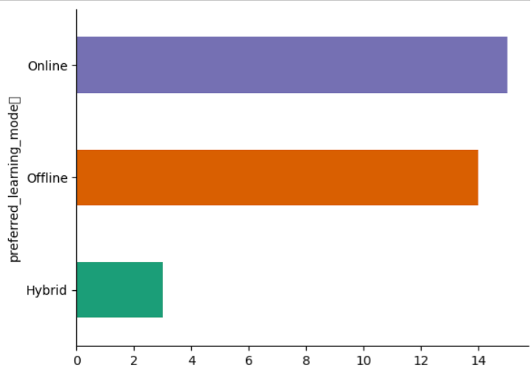
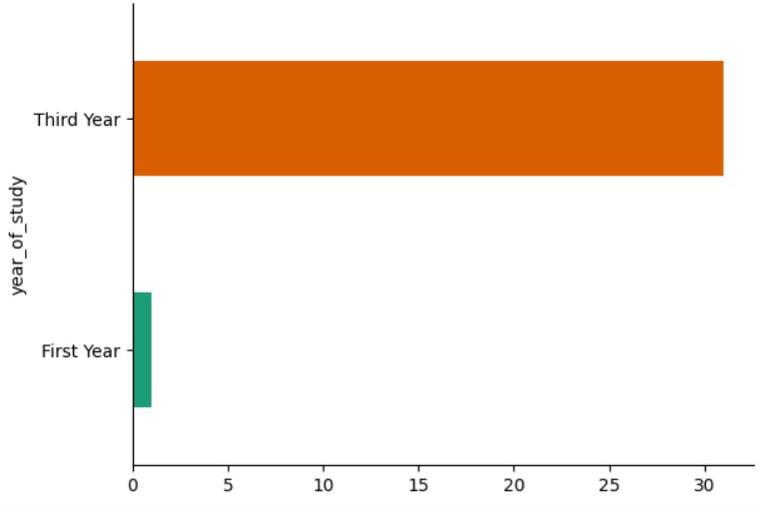
bar & pie charts
Notes:
Ensures that all records belonging to the same category go to the same reducer.
Uses only category for partitioning.
Ensures that all records for a category go to the same reducer.

Slide 10
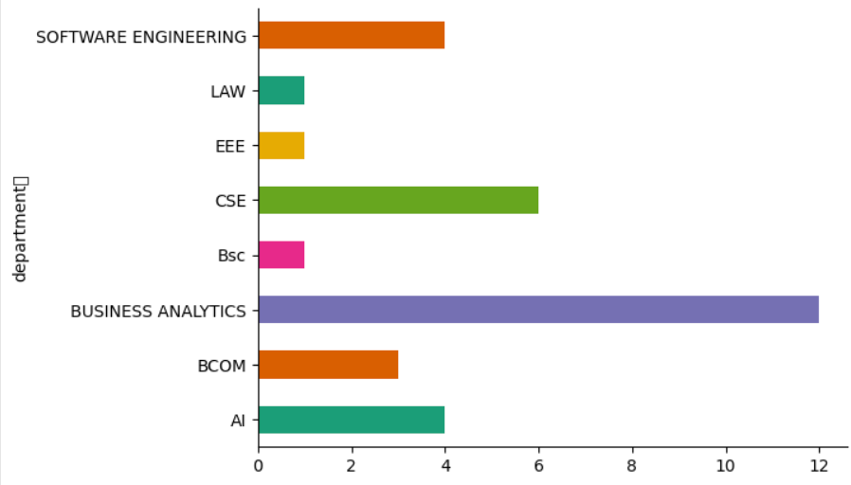
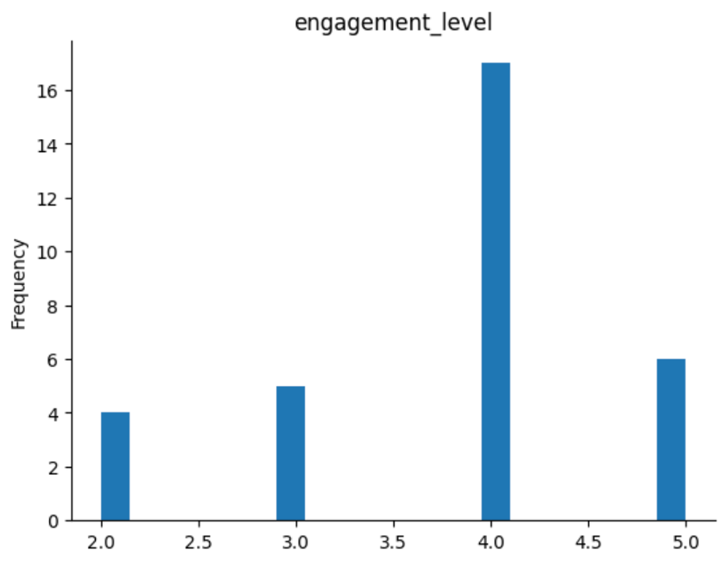
bar & pie charts
Notes:
Ensures that all records belonging to the same category go to the same reducer.
Uses only category for partitioning.
Ensures that all records for a category go to the same reducer.

Slide 11
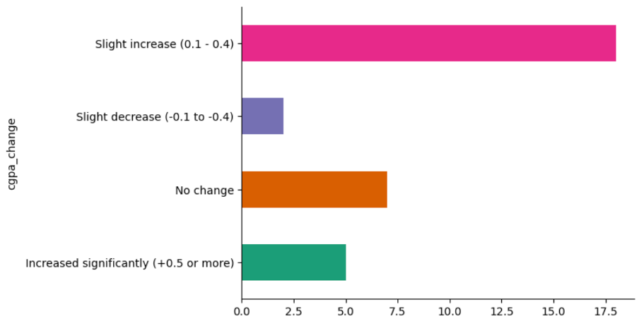
bar & pie charts
Notes:
Ensures that all records belonging to the same category go to the same reducer.
Uses only category for partitioning.
Ensures that all records for a category go to the same reducer.

Slide 12
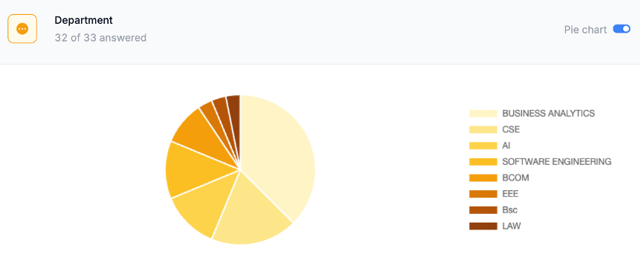
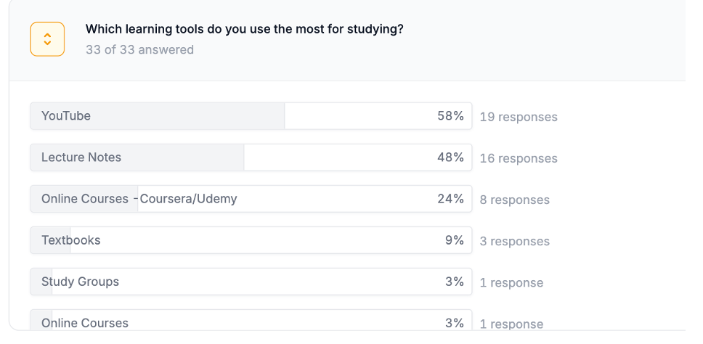
bar & pie charts
Notes:
Ensures that all records belonging to the same category go to the same reducer.
Uses only category for partitioning.
Ensures that all records for a category go to the same reducer.

Slide 13
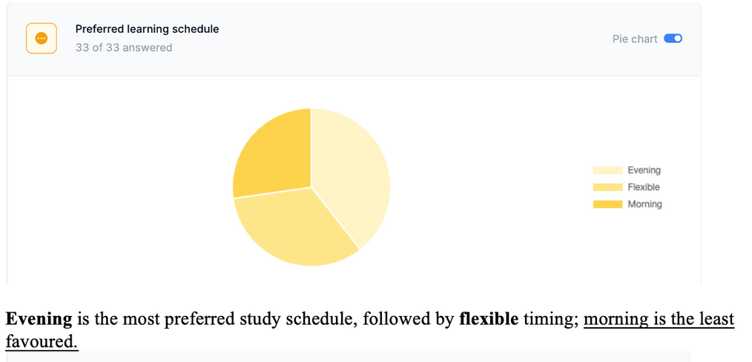
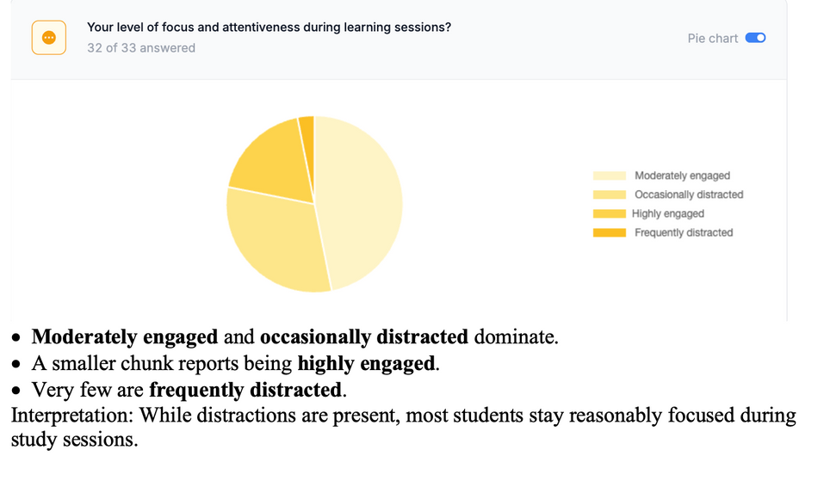
bar & pie charts
Notes:
Ensures that all records belonging to the same category go to the same reducer.
Uses only category for partitioning.
Ensures that all records for a category go to the same reducer.

Slide 14
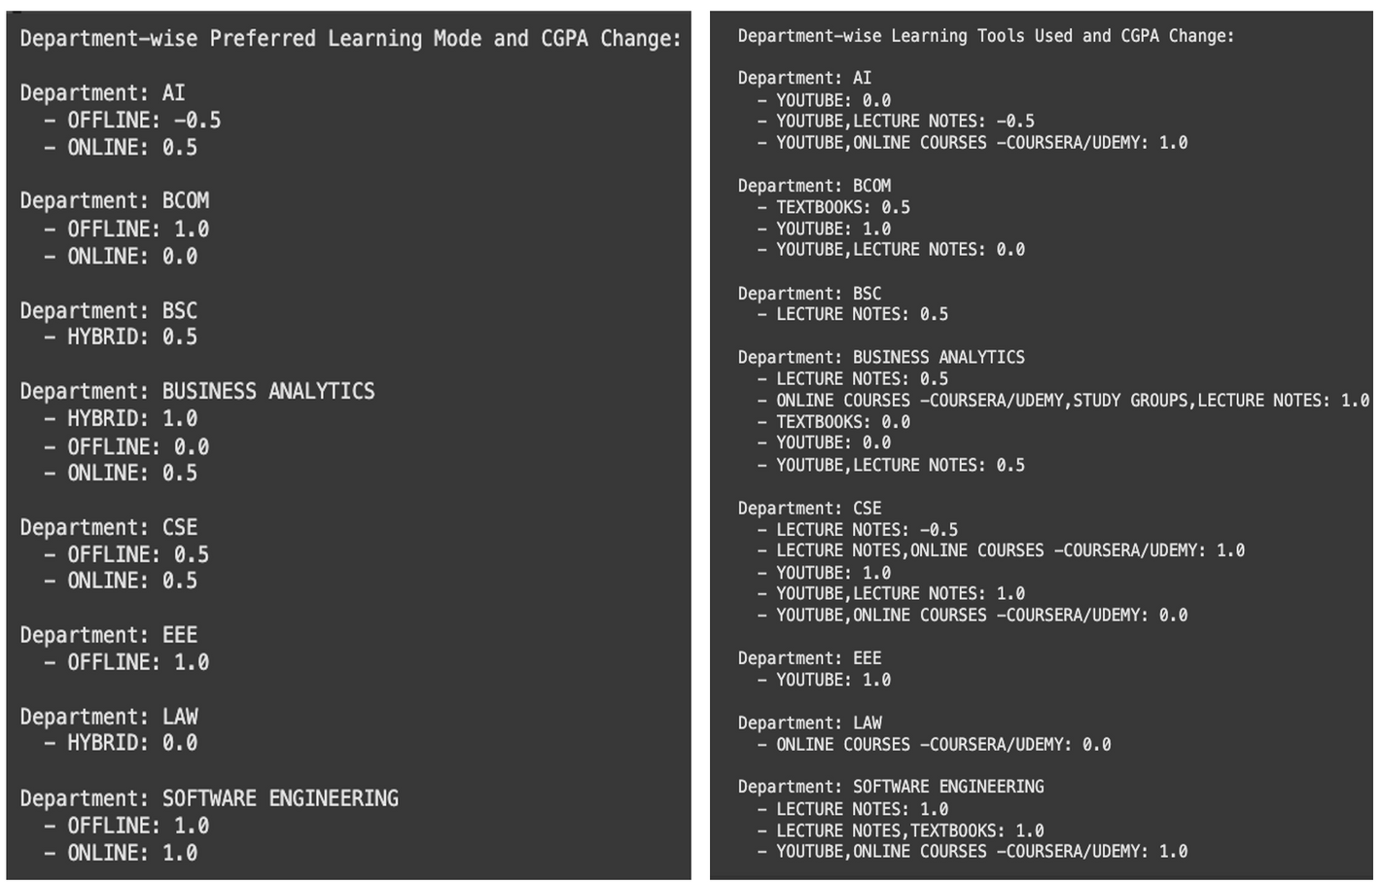
Grouping and Summarising mean CGPA across departments
The learning_mode_efficiency output shows, for example, in the AI department, the average CGPA change is -0.5 for OFFLINE mode and 0.5 for ONLINE mode.
The learning_tool_efficiency output shows, for instance, in the BCOM department, using TEXTBOOKS results in an average CGPA change of 0.5 while using YOUTUBE leads to an average CGPA change of 1.0.
Notes:
Ensures that all records belonging to the same category go to the same reducer.
Uses only category for partitioning.
Ensures that all records for a category go to the same reducer.

Slide 15
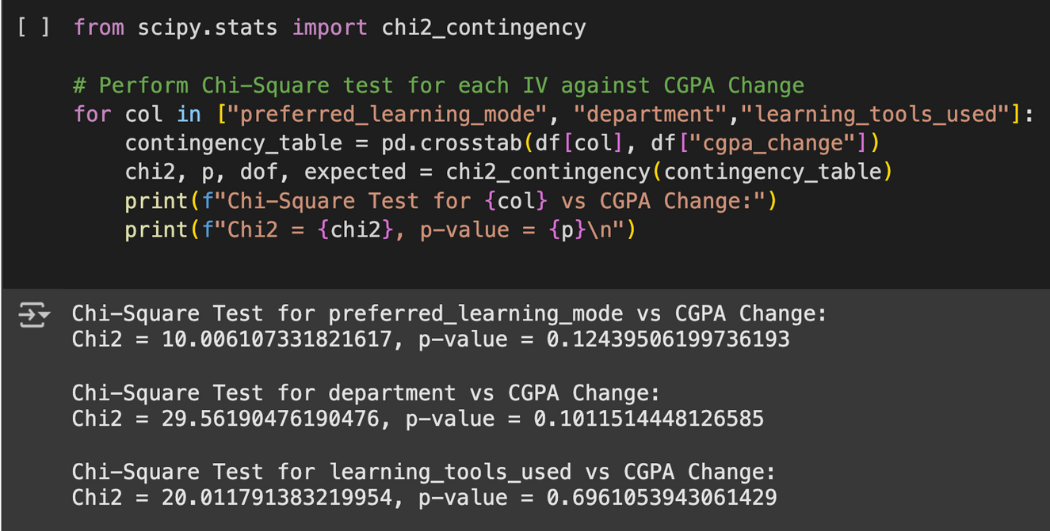
Chi-Square Test
Based on the Chi-Square test results, all p-values for the independent variables Preferred Learning Mode, Department, and Learning Tools Used were greater than 0.05. This indicates that none of these variables have a statistically significant impact on CGPA change.
Notes:
Ensures that all records belonging to the same category go to the same reducer.
Uses only category for partitioning.
Ensures that all records for a category go to the same reducer.

Slide 16
Interpretation & Summary
While learning tools and modes influence engagement, they do not significantly affect CGPA.
These findings suggest that academic outcomes are likely shaped by more complex and individualized factors beyond surface-level preferences or tools. While learning modes and tools may enhance subjective learning experiences, they are not standalone predictors of academic success.
Notes:
1. Mapper (ProductMapper)
Reads input, parses it, and emits a (ProductKey, price) pair.
Reads CSV lines (e.g., "Electronics, 500").
Extracts category and price.
Emits (ProductKey, price), where ProductKey contains both fields.

Slide 17
thank you

